Slide 1
Microsoft 365 Copilot Business GTM Playbook
Your guide to winning the SMB AI opportunity
Updated: December 2025

Slide 2
Welcome
Table of Contents
01
The Opportunity
06
Go-to-Market Approach
02
Microsoft 365 Copilot Business
07
Marketing Activation
Small and medium businesses (SMBs) are at a turning point. They need to do more with less, and AI delivers exactly that—streamlining workflows, automating tasks, and freeing up time for what matters most.
This playbook will equip you, with everything you need to seize this opportunity and help SMBs make AI-powered productivity their new standard.
03
Copilot Business Bundle Offers
08
Reference Material
04
Messaging & Positioning
09
Partner Services
05
Promotional Offers
10
Resources

Slide 3



The largest untapped market for AI productivity
THE OPPORTUNITY
Small and medium businesses represent the largest untapped market for AI-powered productivity.
These organizations are under constant pressure to do more with less, making efficiency and automation critical to their success. AI delivers exactly that—streamlining workflows, reducing manual tasks, and freeing up time for strategic work.
Momentum is building fast: many SMBs are already experimenting with generative AI through consumer tools, but they need trusted solutions that are secure, integrated, and designed for business.
Unlocking the opportunity:
The moment has come to redefine what productivity means for SMBs. AI can no longer be seen as a luxury or a “nice to have”—it must become the new standard for businesses that want to compete, grow, and thrive.
This is more than a technology shift; it’s a transformation in how work gets done. With Microsoft 365 Copilot Business and our new Microsoft 365 Copilot Business Bundles, you have the power to help customers embrace this future and unlock outcomes that truly matter—greater efficiency, smarter decision-making, and accelerated growth.
80%
of SMB users are bringing their own AI tools to work¹
¹Data sourced from 2024 Work Trend Index Annual Report 26 from Microsoft and LinkedIn

Slide 4
Microsoft 365 Copilot Business
A copilot for every user
Microsoft 365 Copilot Chat
Use secure, web-grounded AI chat powered by the latest large language models
Get Copilot Chat in select Microsoft 365 apps¹
Access and use agents, priced on a metered basis
Maintain IT control, including enterprise data protection and agent management
AI-powered productivity isn’t one-size-fits-all—every SMB needs solutions that meet them where they are. Our vision is simple yet bold: to put a Copilot in the hands of every user, transforming how work gets done.
Microsoft 365 Copilot Chat is available at no cost and provides web-grounded AI assistance. It’s the perfect entry point for SMBs to experience the value of AI in everyday tasks—research, drafting, and quick answers—without complexity or additional investment.
For SMBs ready to take AI productivity to the next level, available December 1, 2025, Microsoft 365 Copilot Business brings generative AI directly into the Microsoft 365 apps they use every day—Word, Excel, Outlook, and more.
Built to scale up to 300 employees and those on Microsoft 365 Business plans, Copilot Business delivers the same powerful features and capabilities as Microsoft 365 Copilot—at a 30% savings. This makes enterprise-grade AI accessible to SMBs, enabling them to do more with less and compete at a whole new level.
Together, Copilot Chat and Copilot Business create a clear, affordable path for SMBs to adopt. This is how we make AI-powered productivity the new standard for every business.
Included+ Metered
New! Microsoft 365 Copilot Business
Everything in Microsoft 365 Copilot Chat, plus:
AI-powered chat grounded in business data
Access work-grounded Copilot in apps
Create and use agents with Copilot Studio
Enterprise-grade security, privacy, and compliance
$21 per user/month
View feature comparison
¹ Copilot Chat is available at no additional cost to all Microsoft Entra ID users with an eligible Microsoft 365 subscription. An Azure subscription is required to use agents and is priced on a metered basis.

Slide 5













Microsoft 365 Copilot Business bundle offers
The all-in-one AI Productivity solution
All-in-one AI Solution
With Copilot Business, we have the chance to make AI-powered productivity the new standard for SMBs—not an add-on.
To simplify adoption, we’re bundling Copilot Business with qualifying Microsoft 365 Business plans, creating an all-in-one solution that feels natural and effortless.
Instead of positioning Copilot as a standalone SKU, make it part of the core productivity experience—helping customers see AI as essential to how they work.
These convenient bundles will be available in multiple configurations, with and without Teams.
The productivity apps you love
AI you can trust
+ more
Business Basic + Copilot Business ($27 user/month)
Microsoft 365 Business
Microsoft 365 Copilot Business
Business Standard + Copilot Business ($33.50 user/month)
Business Premium + Copilot Business ($43 user/month)
Compare Copilot Plans

Slide 6
Messaging & positioning
Speaking SMB’s Language
Small and mid-sized businesses deserve more than just tools—they need solutions that simplify daily operations, fuel growth, and protect what matters without adding complexity or extra costs.
Clear, consistent messaging helps you articulate the value of AI-powered productivity and position Microsoft 365 Copilot Business as essential for small business success.
We have conducted research and have developed more aligned messaging and positioning for our Copilot offerings.
Core Messaging Pillars
01
Get more value with one, simplified solution
02
Run your business with confidence
Messaging available for the following
Microsoft 365 Copilot Business
03
Built in security you can trust
Microsoft 365 Copilot Business bundle offers
Microsoft 365 Copilot Business bundle offer (Basic)
Microsoft 365 Copilot Business bundle offer (Standard)
Microsoft 365 Copilot Business bundle offer (Premium)

Slide 7
How to position Microsoft 365 Copilot Business
MESSAGING & POSITIONING
The below provides guidance on how we can communicate the value of Microsoft 365 Copilot Business to small business customers.
Get more value with one, simplified solution
Run your business with confidence
Built-in security you can trust
Copilot is integrated into your existing productivity tools, so you don’t have to navigate across separate AI experiences.
Copilot provides relevant, personalized assistance, so you can make faster, more informed decisions.
Your data stays safe with Microsoft’s trusted security, privacy, and compliance controls to give you peace of mind as your business grows.
Single solution: One AI solution that works across your business and is included with your Microsoft 365 Business plan
Connected experience: Copilot works across familiar apps like Teams, Outlook, Word, Excel and PowerPoint, no context-switching required
Unified interface: The Copilot app unifies chat, search, apps and agents in a single, easy-to-navigate experience
Relevant context: Copilot is grounded on your work data across calendars, emails, chats, documents and meetings to improve relevance and accuracy
Ability to customize: Add your own data and build your own custom agents with minimal coding experience required
Role-based solutions: Get tailored AI experiences across various roles like Sales, HR, and Marketing
Protect sensitive data: Copilot follows your existing security, privacy, and compliance settings
Allow your data to stay with you: Only surfaces what users have permission to access; never used to train foundation models
Adopt AI safely: Reduce oversharing and keep your business data governed and protected

Slide 8
Positioning Microsoft 365 and Copilot Business bundles
MESSAGING & POSITIONING
This section lays out a complete framework for positioning Copilot Business Bundles with SMB customers. It starts with top-level messaging that tells the bigger story—why bundles matter and how they make AI adoption simple by turning AI-powered productivity into the new standard. From there, it dives into bundle-specific positioning, offering clear, value-driven messages for each option. These messages are designed to help you confidently communicate the unique benefits of every bundle through an AI-first lens, ensuring customers see Copilot as essential to their productivity journey
Top Level Positioning
Thes new Microsoft 365 Copilot Business bundle offers combine best-in-class productivity tools with AI built for work, so you get familiar Microsoft 365 apps—Word, Excel, Outlook, and more—plus intelligent assistance that helps you work smarter, faster, and more creatively.
Business Basic + Copilot Business
Business Standard + Copilot Business
Business Premium + Copilot Business
Essential web-based productivity tools and AI in one simple bundle.
All Microsoft 365 desktop apps and cloud services, now with built-in AI.
AI-powered productivity and advanced security in one comprehensive solution.
Do more with less switching. Copilot can draft emails, summarize chats, and create content without having to manage multiple AI tools.
Web access. Chat with Copilot directly in your web browser across any device for easy access.
Built-in security. Copilot runs in Microsoft’s secure cloud, so your prompts and answers stay protected.
Create faster. Use Copilot to write, rewrite, summarize, and build content across Word, Excel, PowerPoint, Outlook, and Teams
Keep work flowing. The Copilot app unifies chat, search, apps, and agents so teams can find, create, and act from one place.
Stay secure everywhere. Copilot uses Microsoft 365’s built-in protections like encryption and multi-factor sign-in to keep your data safe online and in app.
Stronger safeguards. Pair Copilot with Business Premium’s advanced security and device management so sensitive work stays protected.
Automate busywork. Let Copilot recap meetings, draft responses, and transform files into usable outputs, so your team can focus on customers.
One platform, fewer vendors. Consolidate tools, reduce toggling, and get built‑in security to minimize your administrative load.

Slide 9
Tailoring the message for SMB focused industries
MESSAGING & POSITIONING
Small businesses want solutions that truly solve their challenges. To connect in a meaningful way, we need to speak their language—addressing what matters most in their world and their industry. In the following section, you’ll find tailored variations of our core messaging pillars, designed specifically for SMB-focused industries to drive relevance and spark excitement.
Spend less time on admin and more time serving clients
Get more done: Draft proposals, contracts, and client emails faster.
Simplify workflows: Capture meeting notes, action items, and follow-ups automatically.
Protect your firm: Ensure sensitive client data stays private with zero extra setup.
1
Professional Services
→
Build more, manage less. Copilot keeps your projects moving with less admin and more clarity.
Get more done: Draft bids, proposals, and progress reports quickly.
Simplify workflows: Summarize site updates, track tasks, and manage change orders.
Protect your business: Secure project data and financials with enterprise-grade safeguards.
2
Construction
→
Copilot helps your agency spend less time on busywork and more time delivering standout ideas
Get more done: Draft proposals, contracts, and communications in the apps you already use.
Simplify workflows: Turn meeting notes, action items, and follow-ups.
Protect your agency: Keep sensitive client data private with built-in security and compliance.
3
Creative Agencies
→

Slide 10
Introductory Pricing: A catalyst for AI adoption
Promotional offers
With the launch of Microsoft 365 Copilot Business and the Copilot Business bundle offers, we’re introducing limited-time promotional pricing designed to create excitement and accelerate adoption.
These offers aren’t just discounts—they’re a strategic lever to turn routine renewals into powerful upgrade moments and open doors for mid-term upgrades. Use these offers to create urgency using the limited-time savings to shift the conversation from “Why AI?” to “Why wait?” These offers are designed not just to reduce cost but to remove friction—making AI adoption a clear, compelling choice for every SMB.
To make AI adoption simple and irresistible, we’ve introduced a set of promotional offers designed to meet SMB needs and create clear upgrade paths. These offers will run from 12/1/25 through 3/31/2026.
15% off Microsoft 365 Copilot Business add-on This promotion makes it easier for customers who want to start with Copilot as an add-on to experience AI-powered productivity.
Up to 35% off Microsoft 365 Business + Copilot Business bundles Promotional bundles combine Microsoft 365 Business Standard or Premium with Copilot Business in one SKU—making AI a natural extension of productivity. As our hero motion, lead with bundles to help customers upgrade seamlessly from core productivity to AI-powered work at an unbeatable price.
50% off Microsoft Purview Suite for Business Premium* For security-conscious customers, we’re adding a Purview Suite promotion to create an opportunity to pair AI innovation with enterprise-grade security, addressing one of the biggest SMB concerns.
15%off
1-300 licenses
35%off
10-300 licenses
25%off
10-300 licenses
30%off
10-300 licenses¹
50%off
1 -300 Licenses
Microsoft 365 Copilot Business
Microsoft 365 Business Standard + Copilot Business
Microsoft 365 Business Premium + Copilot Business
Microsoft 365 Business Premium + Copilot Business & Purview Suite
Microsoft Purview Suite for Business Premium²
1 This is positioning the combination of the 25% off Business Premium + Copilot Business bundle offer and the 50% off Microsoft Purview offer
²Purview Suite for Business Premium can only be added to customers that have purchase Business Premium and Copilot Business Or Microsoft 365 Copilot
Notes:
For partners, the benefits are compelling. Bundled pricing and CSP incentives provide predictable margins while promotional savings make the offer attractive to customers. Mid-term upgrades allow partners to capture incremental revenue without waiting for renewal, and optional add-ons like Microsoft Purview Suite create additional attach opportunities for compliance-sensitive businesses. Ultimately, these bundles enable partners to lead with innovation, differentiate their offerings, and position AI as the next logical step for SMB customers—whether at renewal or during the term—making every interaction a chance to drive growth and deepen customer relationships.

Slide 11
Scaling AI adoption: Moving from add‑on to essential
Go to market approach
Key barriers
Solution
AI-powered productivity isn’t just a feature—it’s the future of work. With Copilot Business and the new bundles, we have an opportunity to transform the go-to-market approach and accelerate results.
Our strategy shifts Copilot from a standalone, add-on to a core part of the productivity story—because SMBs don’t want extras; they want solutions that help them do more with less. AI is now central to that expectation.
SMBs are under pressure. Many are experimenting with consumer AI tools, inadvertently creating risks with “shadow AI” that fragment workflows and increase security gaps. Partners can change that—positioning AI as essential, not optional. By embedding Copilot into Microsoft 365 licensing, we deliver a simple, scalable path for secure AI adoption without complexity.
SMBs are price-sensitive, short on time and resources, and often unsure how to start their AI journey. To make our strategy successful, our go-to-market approach must evolve to overcome these business barriers.
The Solution: Drive adoption by making Copilot Business an easy choice. Use promotional pricing to remove barriers, position it as “AI out-of-the-box” with zero setup, and lead with bundled offers as the fastest, simplest upgrade—delivering immediate value right in the flow of work.
01
Price Sensitive
SMBs operate on tight budgets and perceive AI as expensive
Promotional Pricing
New discounted offers make Copilot the most affordable way for SMB’s to adopt AI.
02
Limited Resources
SMBs lack bandwidth for pilots or complex deployments.
Out-of-the-Box AI
Position Copilot Business as a turnkey, zero-setup solution—built into the apps SMBs already use.
02
Value Realization
They know AI matters but don’t know where to begin
Lead with bundles
Use Copilot Business bundles to connect AI value directly to core productivity.

Slide 12
Tapping into the immediate growth opportunity
Go to market approach
Turn every renewal into an AI upgrade
To accelerate AI adoption, simplicity is key. By combining new bundle offers with promotional pricing, we remove complexity and make it easy for customers to choose a single solution for secure, AI-powered productivity—with the option to add Microsoft Purview Suite for advanced data protection.
This is a unique opportunity to deliver an offer that resonates. We’ve identified two primary motions to maximize impact by leveraging these offers and promotional pricing:
Renewal Motion: With our largest renewal wave approaching, you can turn routine renewals into secure AI upgrades by leading with bundle offers priced to win.
Mid-Term Motion: For customers not up for renewal, there’s still a strong opportunity to drive AI adoption. Lead with the Copilot Business Standalone offer.
Enhanced Security, with an AI productivity upgrade
Same great plan, with an AI productivity upgrade
Drive mid-term AI attach and expansion
Expand AI productivity to every user
Get started with Copilot for less

Slide 13
Turn every renewal into an AI upgrade
Go to market approach
Renewals are your most strategic opportunity to drive AI adoption—especially with new promotional offers creating a compelling event.
The key is to meet customers where they are and make the path forward simple. We have defined an approach to capitalize on this opportunity.
Hero motion: Lead with the all-in-one bundle for secure, AI-powered productivity. Position this as the ultimate upgrade—advanced security plus AI in a single step for maximum value.
Fallback Approach: For customers not ready to go all-in, offer an easy entry point. Position “Stay on your current plan and add AI” as the simplest way to unlock productivity without changing their core subscription.
These options become even more attractive when paired with limited-time promotional pricing, making renewal conversations the perfect moment to upgrade.
Hero
Fallback
Enhanced Security, with an AI productivity upgrade
Same great plan, with an AI productivity upgrade
Microsoft 365 Business Basic
Business Standard + Copilot Business
Business Standard
Microsoft 365 Business Standard
Business Premium + Copilot Business
Business Standard + Copilot Business
+ Purview Suite (Opt. Add-on)
Microsoft 365 Business Premium
Business Premium + Copilot Business + Purview Suite
Business Premium + Copilot Business

Slide 14

Go to market approach
Enhanced Security, with an AI productivity upgrade
Security isn’t optional—it’s essential. That’s why our hero motion combines advanced protection with AI-powered productivity in one comprehensive solution. These upgrade paths make it simple and cost-effective to deliver unmatched security and intelligence.
By upgrading customers to Business Premium with Copilot and Purview Suite, you deliver the most secure AI experience available—protecting sensitive data while unlocking intelligent workflows. Lead with security as the differentiator and show customers why this is the smartest way forward.
M365 Business Standard
+$25
Business Premium + Copilot and Purview
The most secure AI solution for your business
Renewal
Hook
“Secure your business and supercharge productivity with AI for just $20 more per user/month. Add enhanced security and compliance for only $5 extra.”
M365 Business Premium
+$15
Business Premium + Copilot and Purview
Renewal
Hook
AI-powered productivity & advanced security in one comprehensive solution.
Upgrade now for a smarter, more secure way to work. Just $15 more per user/month”

Slide 15
Go to market approach
Same great plan, with an AI productivity upgrade
For customers who aren’t ready to make the full leap to advanced security and AI, there’s still a simple, cost-effective way forward—add Copilot to the plan they already know and love. Choosing the right upgrade path is key to unlocking AI for every customer.
Whether they’re on Business Basic, Standard, or Premium, these options make adoption effortless and affordable, with limited-time pricing. For customers on Business Standard or Business Premium they can upgrade to the bundle offer with Copilot for just $10 more.
M365 Business Basic
+$16
Business Standard + Copilot Business
Renewal
Hook
From everyday work to extraordinary results: Desktop apps and cloud services, now with AI at the heart of your workflow. Upgrade now and save 35%.”
The all-in-one AI solution for your growing business
M365 Business Standard
+$9.50
Business Standard + Copilot Business
M365 Business Premium
+$10
Business Premium + Copilot Business
Renewal
Hook
“Work smarter, not harder. Unlock AI-powered productivity for just $10 more per user/month for a limited time.”

Slide 16
Go to market approach
Drive mid-term AI attach and expansion
For customers not up for renewal, there’s still a strong opportunity to drive AI adoption. Lead with the Copilot Business Standalone offer, now available at 40% off previous pricing (i.e. $30 user/month), to help existing Copilot customers expand Copilot to more users across their organization.
For customers just starting their AI journey, the standalone offer is the perfect entry point. Begin with 3–5 users to build confidence, demonstrate value, and create momentum ahead of their renewal—making future expansion seamless and cost-effective.
M365 Business Suites with Copilot
+$18
Expand with M365 Copilot Business
The all-in-one AI solution for your growing business
Mid-term
Hook
You’ve proven the value—now maximize it. Expand Copilot to more users at new, lower pricing – 40% less than before.
M365 Business Suites w/o Copilot
+$18
Attach M365 Copilot Business
Mid-term
Hook
Start your AI journey today—add Copilot for only $18 per user/month

Slide 17







Microsoft 365 Copilot Business Marketing
Download Launch Kit
Go to market approach
To accelerate AI adoption, simplicity is key. By leading with new bundle offers, we remove complexity and make it easy for customers to choose a single solution for secure, AI-powered productivity—with the option to add Microsoft Purview Suite for enhanced data protection.
Build your assets. Start with a clear strategy that positions Copilot Business as essential for SMBs. Highlight benefits like flexibility, promo pricing, and immediate AI value. Leverage the Launch Kit for ready-to-use assets that make campaign execution faster and more consistent.
Target customers and drive demand. Segment customers by renewal timelines and business needs. Use personalized outreach, case studies, and ROI messaging to create urgency—mid-term upgrades mean customers don’t wait for renewal. Incorporate Microsoft 1:Many Briefings to land promotional offers at scale and educate customers on why upgrading now delivers maximum value.
Close deals. Simplify the buying process and emphasize full mid-term upgrades for unified licensing and flexibility to add seats at discounted rates. Provide clear pricing, address objections, and position yourself as a trusted advisor helping SMBs future-proof with AI.
Launch kit assets
GTM playbook
Promotional flyers and handouts
Pitch decks
Sales enablement email OFTs
Website template
Social Ads
Product FAQs
To-customer email OFTs
Notes:
.

Slide 18
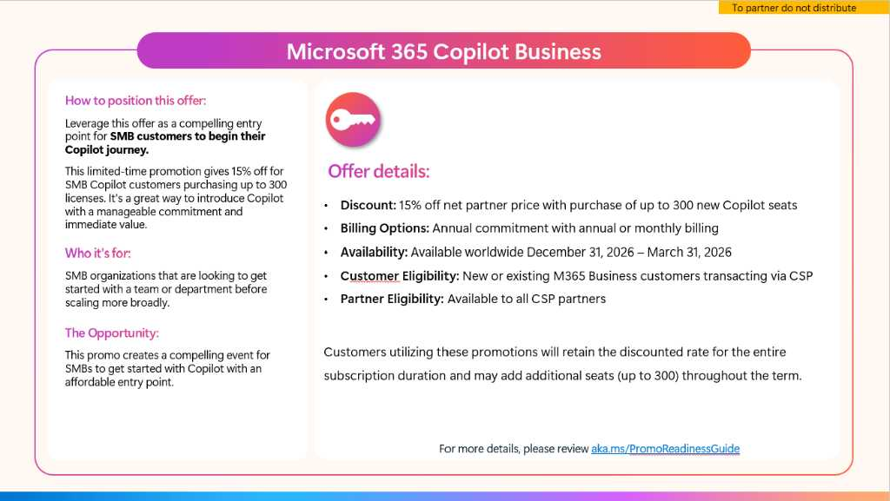
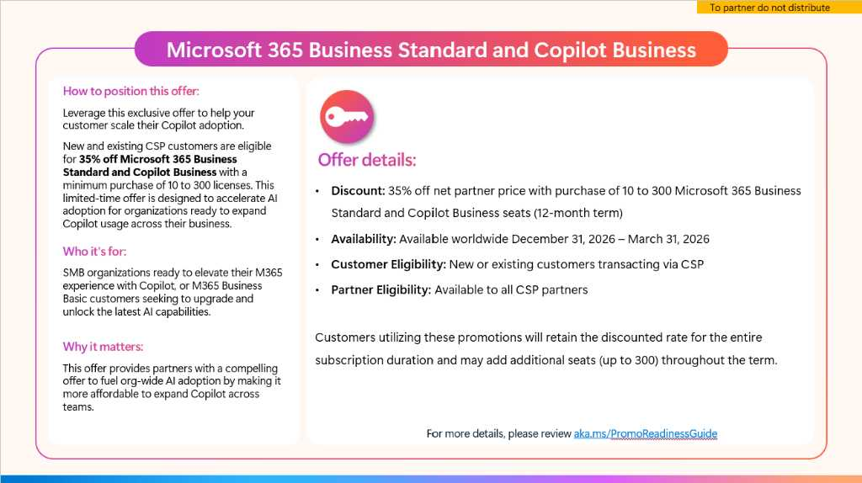
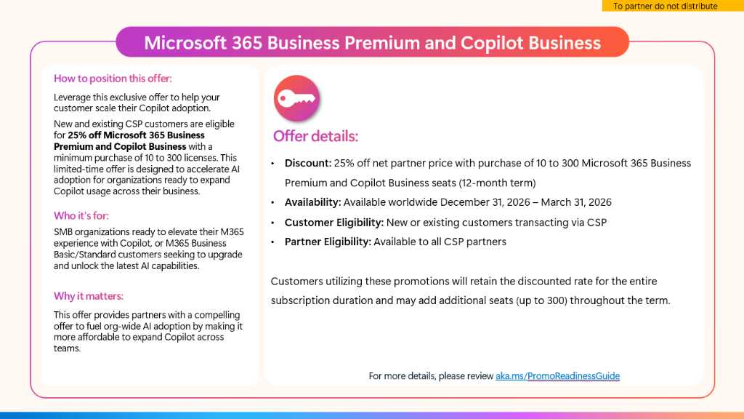
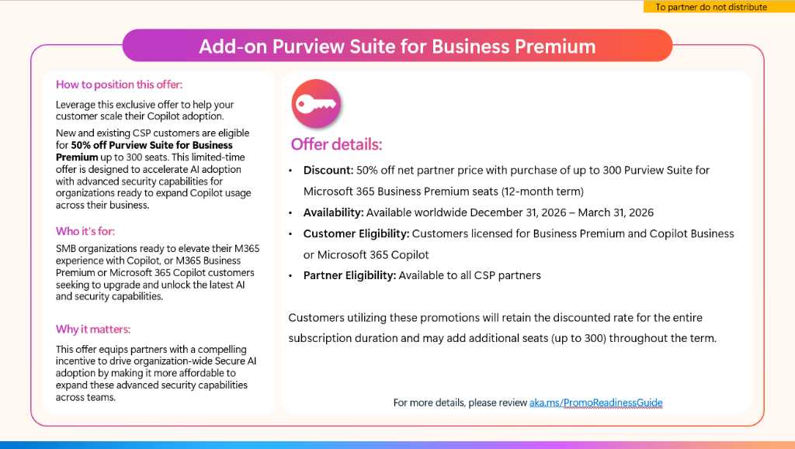
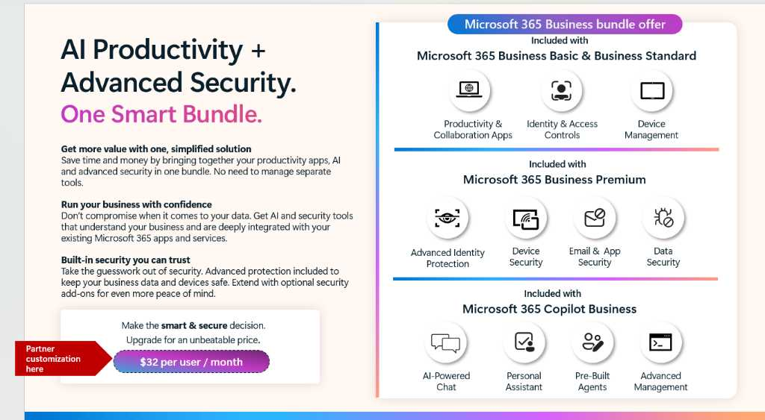
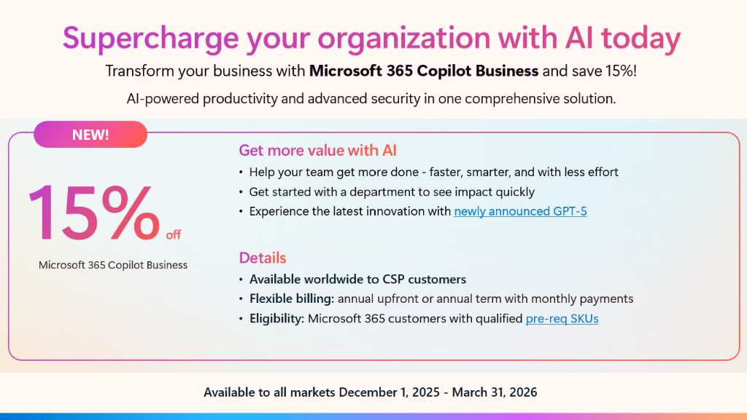
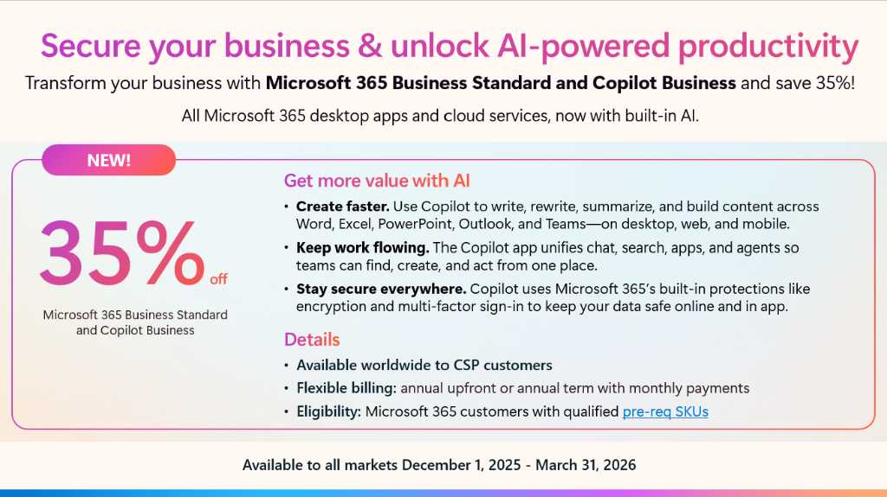
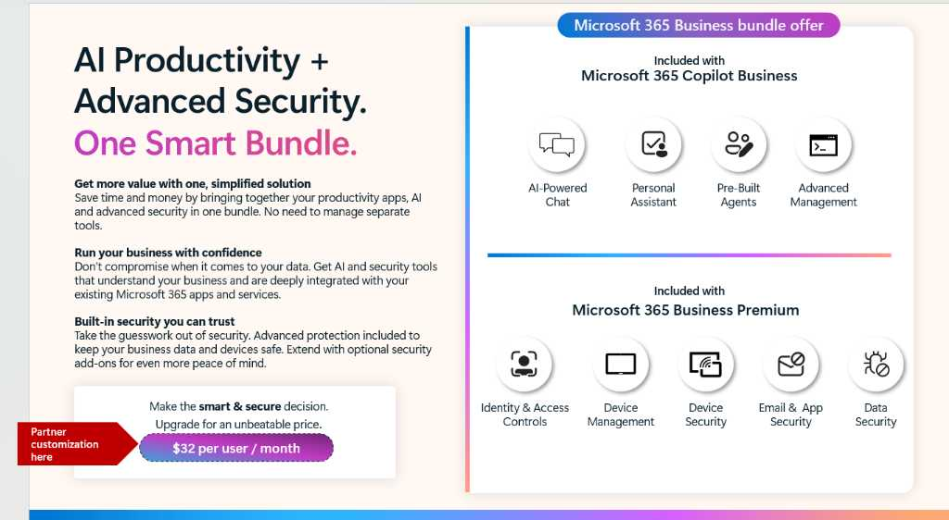
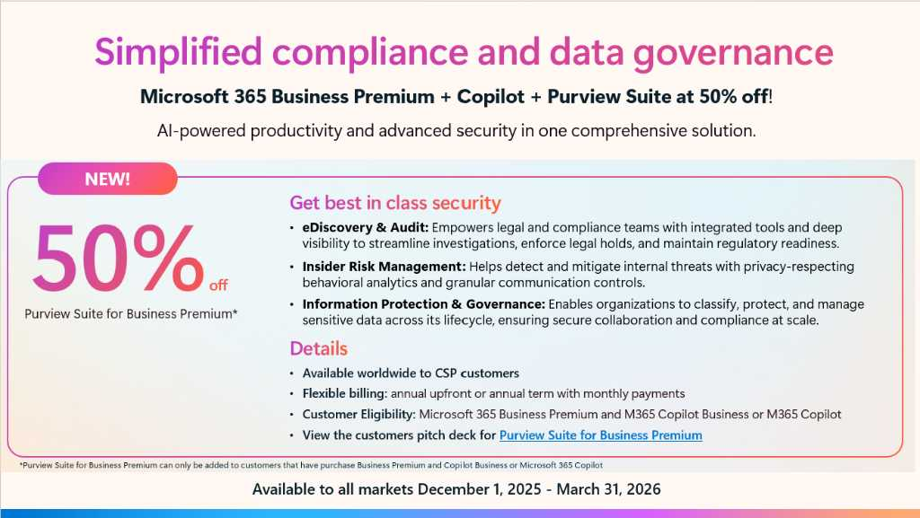
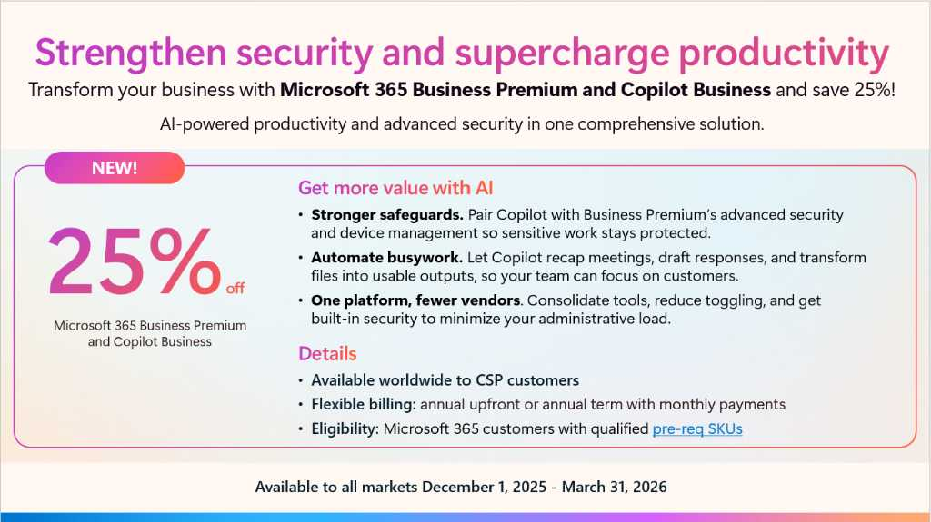
Promotion one-sliders
Marketing activation
Partner promotion details
Easily customize these offer slides and add to your own offer pitch deck or circulate in a to-customer email.
To-Customer M365 Standard + Copilot Business
To-Customer M365 Copilot Business
Asset Details
Size | n/a
Notes | n/a
Design Options | 4 To-Partner variants 6 To-Customer variants
Editable File Type | PowerPoint
File Name | M365 Copilot Business Promotion One Sliders_To-Partner_To- Customer
To-Customer M365 Premium + Copilot Business & Purview

Slide 19
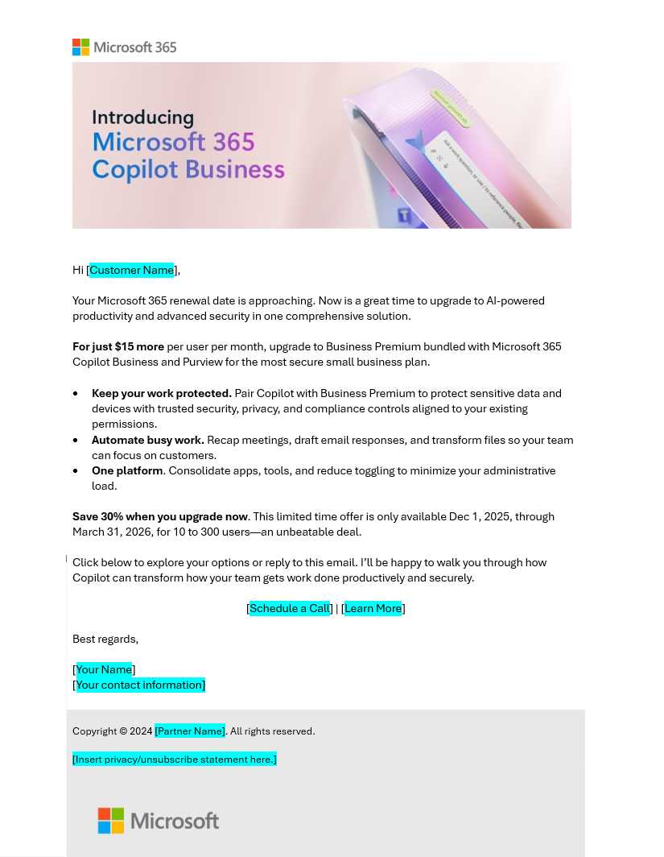
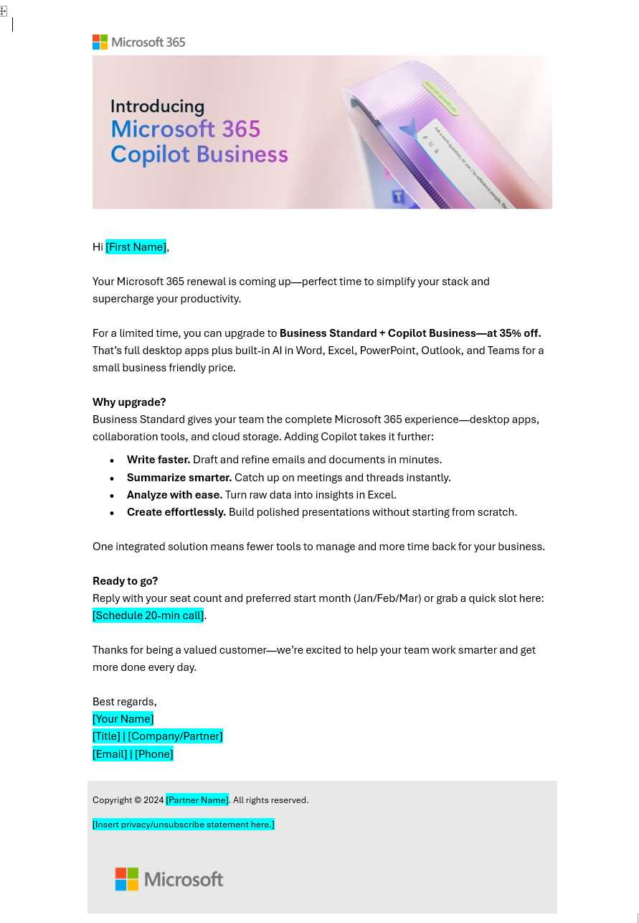
Email: To-Customer
Marketing activation
To-Customer Premium
To-Customer Standard
Customize these email templates to announce and promote your offer to customers.
Asset Details
Size | n/a
Notes | n/a
Design Options | 2 variants
Editable File Type | OFT (Outlook File Template)
File Name | To Customer_Premium To Customer_Standard
Reminder: Once you have the OFT open for editing, update the highlighted text with the appropriate information. Remove the yellow highlight.
Note – If you are using the new Outlook, you need to update the font to Segoe Sans Display or Segoe UI for all copy. Make sure all the originally bolded text is still bolded after the update.

Slide 20
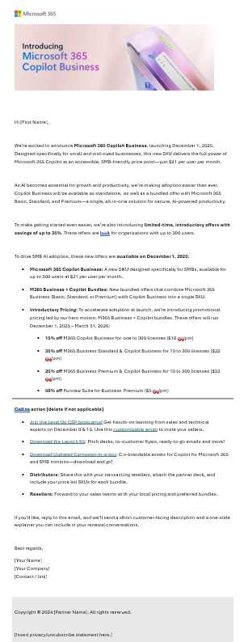
Email: Partner enablement
Marketing activation
Customize these email templates to announce the product news and offers to your sales teams.
Reminder: Once you have the OFT open for editing, update the highlighted text with the appropriate information. Remove the yellow highlight.
Note – If you are using the new Outlook, you need to update the font to Segoe Sans Display or Segoe UI for all copy. Make sure all the originally bolded text is still bolded after the update.
Asset Details
Size | n/a
Notes | n/a
Design Options | 1 variant
Editable File Type | OFT (Outlook File Template)
File Name | To Partner_Reseller

Slide 21
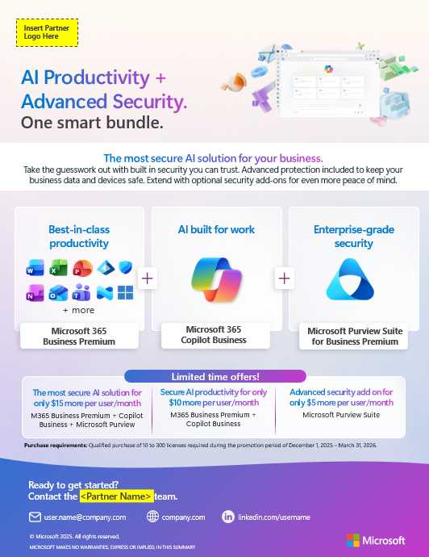
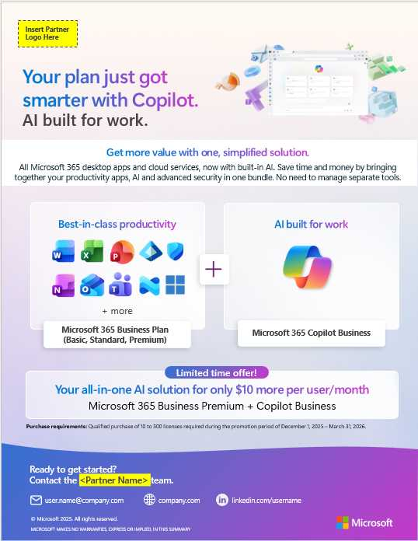
Offer one-pager: announcement
Marketing activation
To-Customer M365 Business Premium Security Bundle
To-Customer M365 Business Standard
Customize this one-pager template to provide promo details to your customers, along with showcasing the value of Copilot
Asset Details
Size | 8.5x11 page
Notes | n/a
Design Options | 2 options
Editable File Type | PowerPoint
File Name | To Customer Flyer_M365 Bus Premium Security Bundle To Customer Flyer_M365 Business Standard

Slide 22
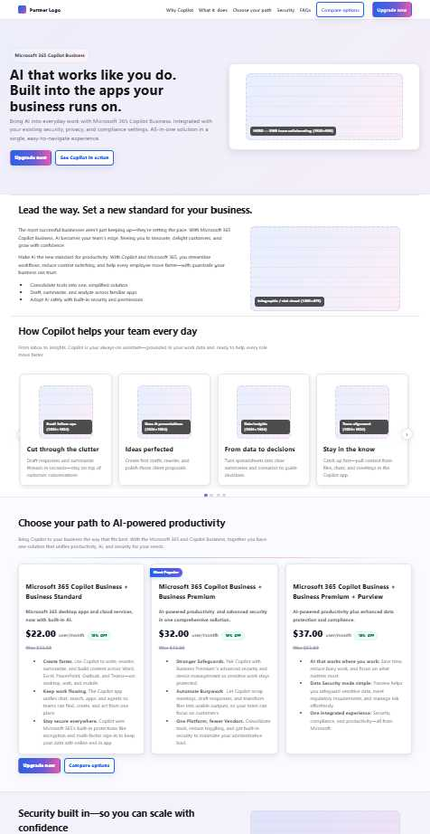
Website template
Marketing activation
Leverage for your corporate webpages. Spread the word on your offer.
Asset Details
Notes | n/a
Design options | Customizable
Editable file type | Html
File name | CopilotBusiness_Website

Slide 23
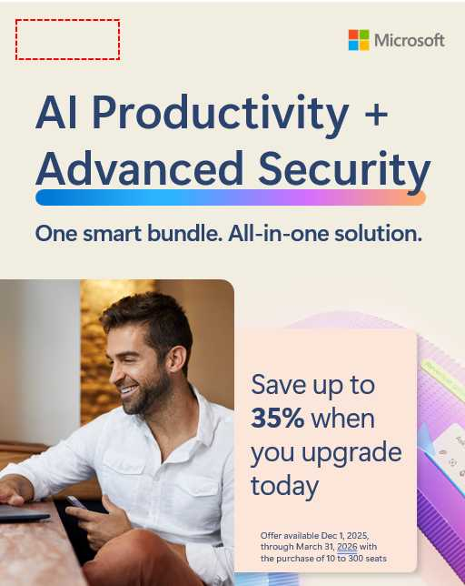
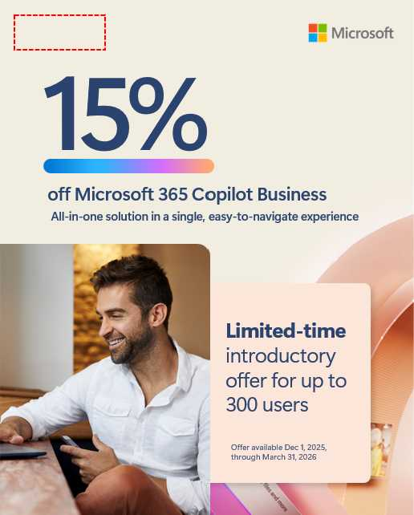
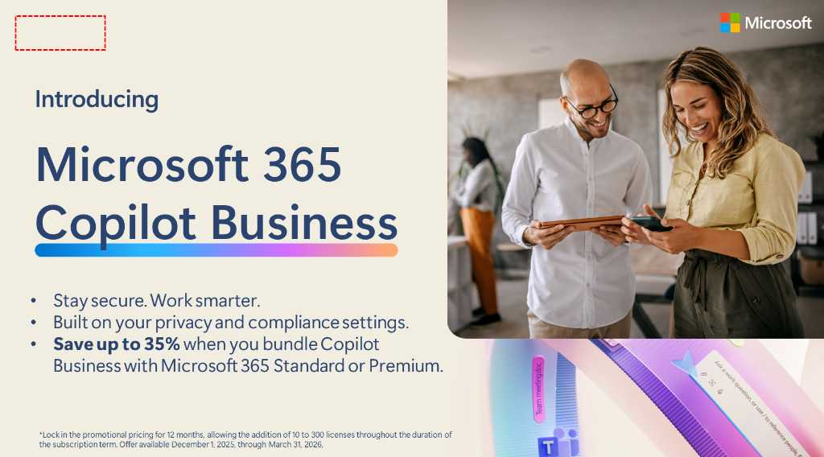
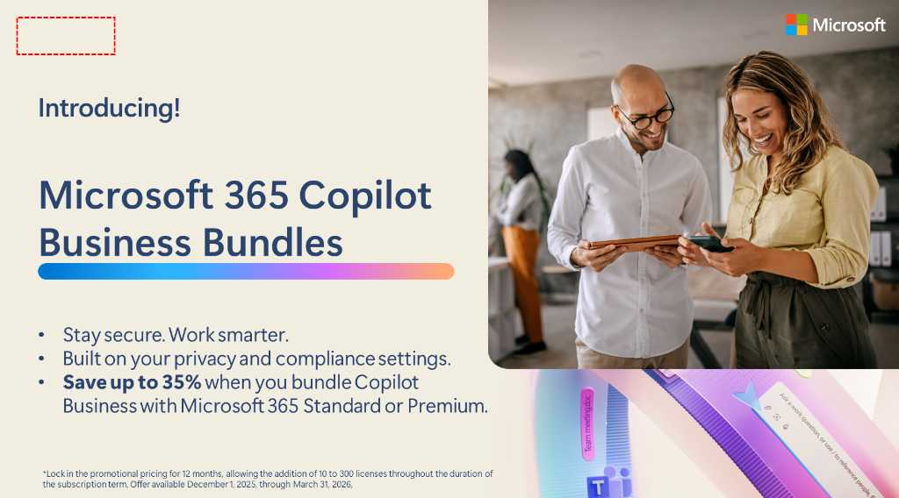
Digital banner
Marketing activation
Place banners in newsletters, social posts, or corporate media and webpages. Spread the word on your offer.
Asset Details
Notes | n/a
Design options | 4 ad options, horizontal and vertical
Editable file type | PowerPoint
File name | M365 Copilot Business_ Social Ad

Slide 24
REFERENCE MATERIAL
Microsoft 365 Copilot feature comparison
Microsoft 365
Copilot Chat
Microsoft 365
Copilot Business ⁵
$21/ user/ month
Microsoft 365
Copilot
$30/user/month
● =Included
▲ =Included- Metered
Licensing | Seats | All users | Up to 300 users | All users
 | Pre-requisite | O/E/B/F SKUs | B-SKUs | O/E/B/F SKUs
Chat | Copilot Chat – Web grounded (powered by GPT 4o) | ● | ● | ●
 | Copilot Chat – Work grounded (shared tenant Graph data, 3rd party data via graph connectors, personal data) |  | ● | ●
 | Copilot Pages | ● | ● | ●
 | File upload¹ | ● | ● | ●
 | Code Interpreter¹ | ● | ● | ●
 | Image generation¹ | ● | ● | ●
Agents² | Create agents powered by Copilot Studio³, including SharePoint agents | ● | ● | ●
 | Discover and pin agents | ● | ● | ●
 | Use agents grounded on web data | ● | ● | ●
 | Use agents grounded in work data (work data in your tenant’s Microsoft Graph and 3rd party data via graph connectors) | ▲ | ● | ●
 | Use agents that act independently and autonomous actions | ▲ | ▲ | ▲
Personal assistant | Copilot reasons over personal work data (i.e. Outlook, OneDrive, meeting transcripts) |  | ● | ●
 | Copilot in Teams (Copilot in Meetings and Meeting Recap, insights from screen-shared content coming soon) |  | ● | ●
 | Copilot in Outlook (Prioritize my inbox, schedule focus time and 1:1 meetings, draft agendas, summarize message threads) |  | ● | ●
 | Copilot in Word (Suggestions for structure, flow, and tone, draft and summarize documents) |  | ● | ●
 | Copilot in Excel (Python, getting started experience, create formulas and visualizations using natural language) |  | ● | ●
 | Copilot in PowerPoint (Narrative Builder, presentation translation, generate company branded slides or images) |  | ● | ●
 | Copilot Actions |  | In preview | In preview
 | Pre-built M365 agents (Interpreter, Facilitator, Project Manager, Employee Self-Service) |  | In preview | In preview
Copilot Control System | Enterprise Data Protection (EDP) | ● | ● | ●
 | IT management controls | ● | ● | ●
 | Agent management | ● | ● | ●
 | SharePoint Advanced Management |  | ● | ●
 | Copilot Analytics to measure usage and adoption⁴ |  | ● | ●
 | Pre-built reports and advanced analytics to measure ROI |  | ● | ●
1. Limits apply. 2. Applies to employee-facing agents only. 3. Learn more about the full capabilities of Copilot Studio here. 4. Basic reporting in Microsoft Admin Center available for Copilot Chat. 5. Microsoft 365 Copilot for Business includes a fixed set of capabilities. Microsoft 365 Copilot for Enterprise may expand to include additional features over time.

Slide 25
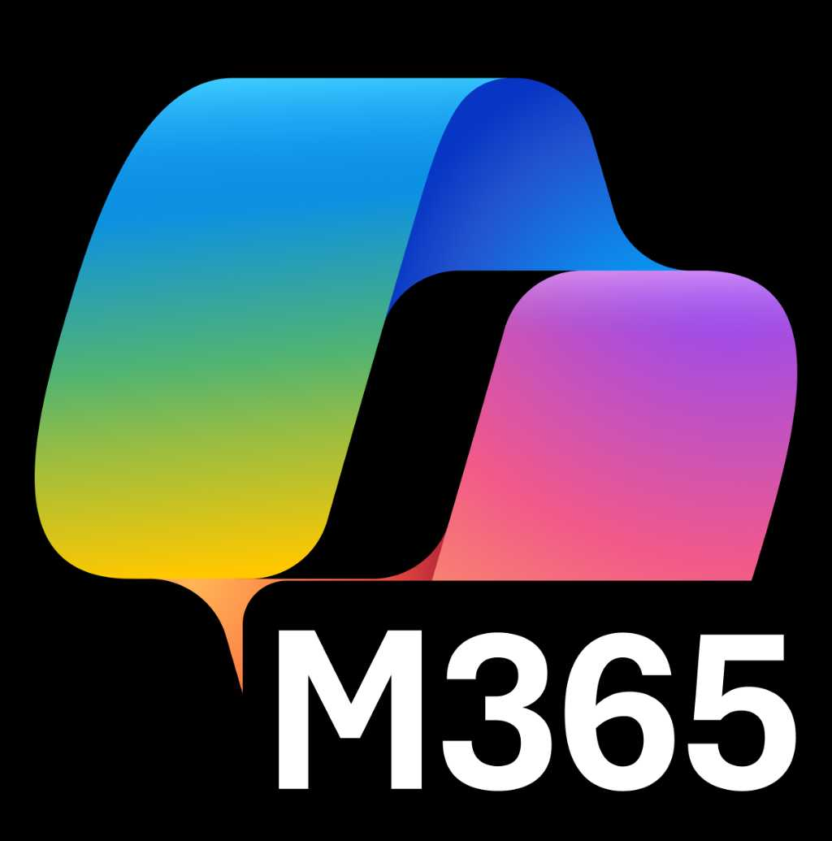
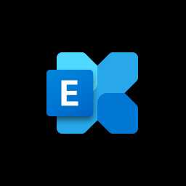
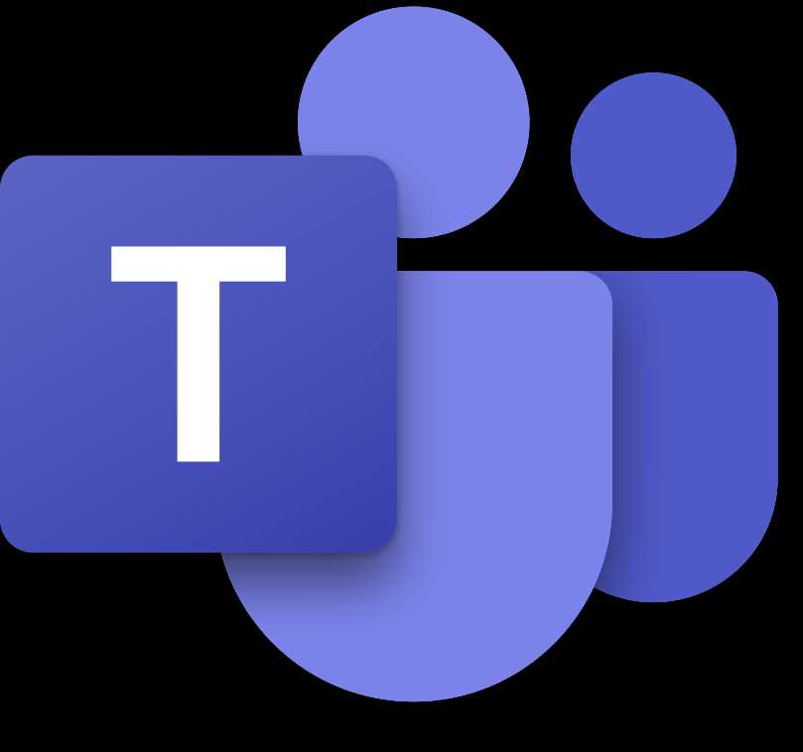


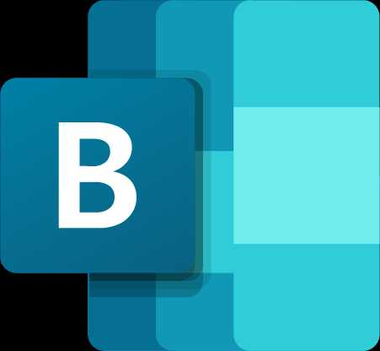
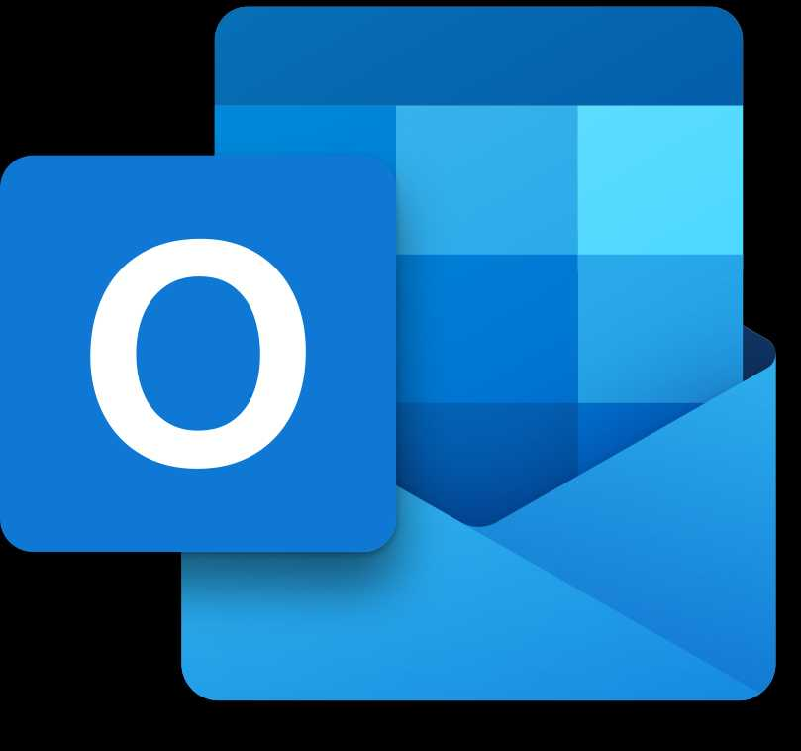
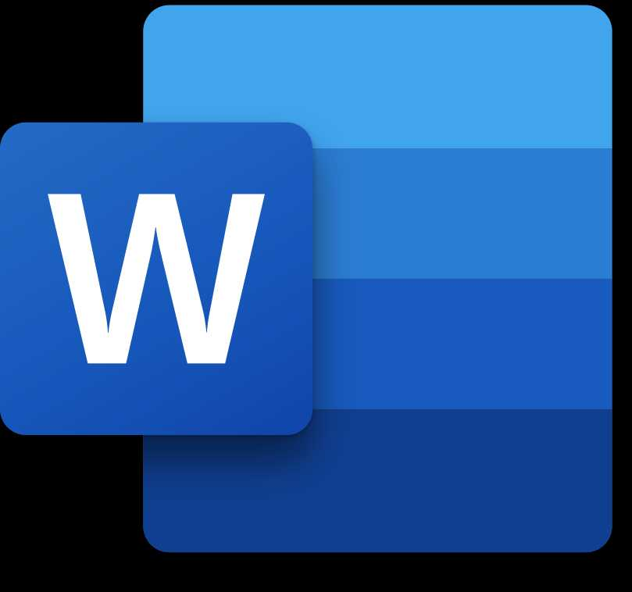
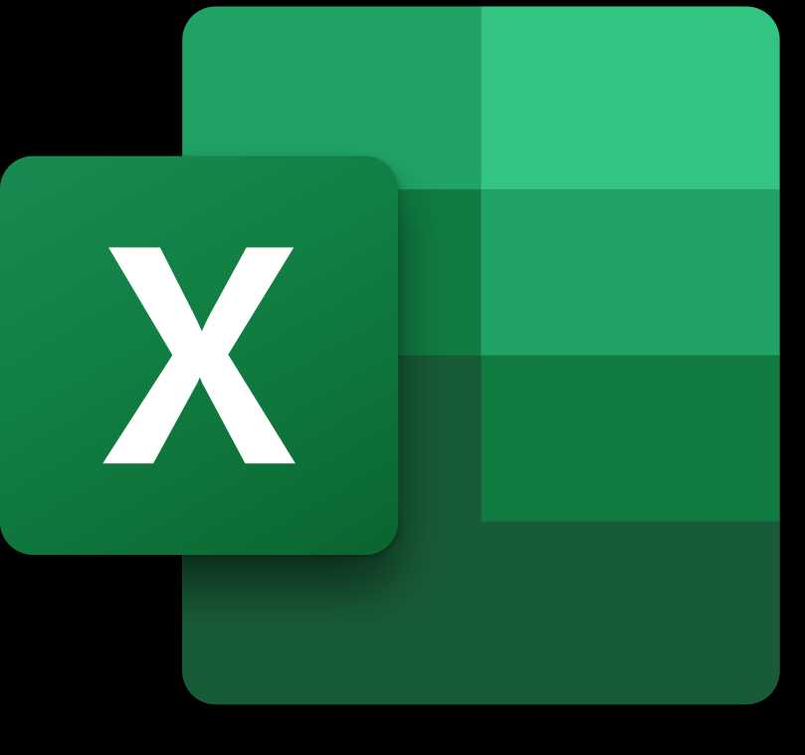
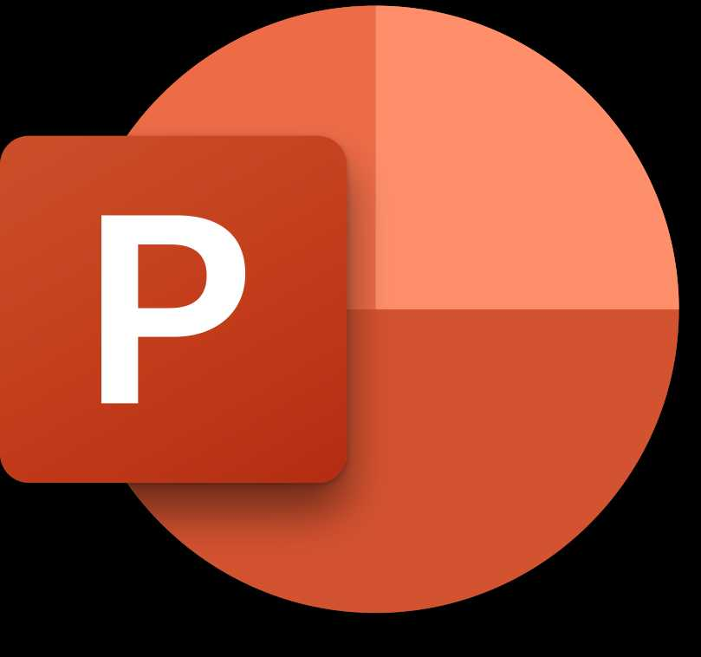








Microsoft 365 Copilot Business offer line up
REFERENCE MATERIAL
Hero Offer
Add-on
Bundle
Bundle
Bundle
Bundle + Add-on
Microsoft 365
Copilot Business
M365 Business Basic
+ Copilot Business
M365 Business Standard
+ Copilot Business
M365 Business Premium
+ Copilot Business
M365 Business Premium
+ Copilot Business or Microsoft 365 Copilot Business & Purview Suite Business Premium*
Supercharge employee productivity and streamline business processes with an AI built for work.
Essential web-based productivity tools and AI in one simple bundle
All Microsoft 365 desktop apps and cloud services, now with built-in AI.
AI-powered productivity and advanced security in one comprehensive solution.
The most secure AI tools for your business
AI-enabled Cloud services
AI-enabled Cloud services
AI-enabled Cloud services
AI-enabled Cloud services
AI-enabled Cloud services
Teams
Exchange
OneDrive
SharePoint
Bookings
Teams
Exchange
OneDrive
SharePoint
Bookings
Teams
Exchange
OneDrive
SharePoint
Bookings
Teams
Exchange
OneDrive
SharePoint
Bookings
AI-enabled web apps
AI-enabled Desktop and web apps
AI-enabled Desktop and web apps
AI-enabled Desktop and web apps
Outlook
Word
Excel
PowerPoint
Outlook
Word
Excel
PowerPoint
Loop
Clipchamp
Outlook
Word
Excel
PowerPoint
Loop
Clipchamp
Outlook
Word
Excel
PowerPoint
Loop
Clipchamp
Built for work
Advanced skills and in-app editing
Comprehensive agent access
Advanced Mgmt. & Analytics
Foundational security
Identity & access control
Exchange Online Protection
Mobile device management
Foundational security
Identity & access control
Exchange Online Protection
Mobile device management
Comprehensive security
Advanced security
Microsoft Intune
Microsoft Entra ID
Microsoft Defender
Microsoft Intune
Microsoft Purview
Microsoft Entra ID
Azure Virtual Desktop
Microsoft Defender
$18 per user/month
$27 per user/month
$22 per user/month
$32 per user/month
$37 per user/month
Limited time promo pricing
Limited time promo pricing
Limited time promo pricing
Limited time promo pricing
*Purview Suite for Business Premium can only be added to customers that have purchase Business Premium and Copilot Business Or Microsoft 365 Copilot Business **Purview Suite for Business Premium is only DLP for emails and files, Intune Plan 1, Entra ID Plan 1.
Learn more about billing options here
Note: Not all features/product logos shown. Price is subject to change based on subscription term, currency and region.
Notes:
As you look at the opportunity to make AI-powered productivity foundational for SMBs, these new AI Productivity Bundles are critical to enabling that strategy.
By combining Microsoft 365 Business and Copilot Business into a single SKU, you simplify the sales motion and remove friction for customers. Instead of positioning Copilot as an add-on, you can now lead with a complete AI-productivity solution—making it easy for SMBs to adopt AI.
These bundles make upgrading simple and ensure every user has the tools to work smarter and are designed to accelerate adoption and make AI-first productivity the new standard.
These bundles are available for Business Basic, Standard, and Premium combined with Copilot Business starting at $27 per user per month, with options with or without Teams available.

Slide 26

Flexible billing options through annual/monthly
Partner services
Microsoft 365 Copilot offers two subscription options: an annual commitment paid yearly, or an annual commitment paid monthly. The yearly payment option allows customers to purchase and pay for the entire subscription term upfront.
Alternatively, the annual commitment paid monthly option provides flexibility designed to provide customers with the benefits of an annual subscription while easing their cash flow. Instead of paying the entire annual subscription upfront, customers can spread the cost over 12 monthly payments. This approach allows businesses to manage their budgets more effectively and invest in additional licenses or services as needed.
Customers who choose this plan will pay a slightly higher rate—5% more than the annual upfront payment option—but will benefit from the convenience of monthly payments. This flexibility is particularly advantageous for businesses looking to scale their use of Copilot without a significant initial investment.
Learn more about Annual/Monthly Billing

Slide 27

Mid-term upgrades: flexible, fast, and cost-effective
Partner services
Upgrading to Copilot Business mid-term gives partners a powerful way to help customers adopt AI without waiting for renewal. The most strategic option is a full mid-term upgrade for all seats, which transitions the entire subscription to include Copilot immediately. This approach simplifies management, ensures consistency across the organization, and unlocks promotional discounts during the upgrade window. By leading with this scenario, partners can position Copilot as an urgent productivity and security enhancement rather than a future consideration.
The alternative is a partial, mid-term upgrade, where only select seats are upgraded. While this can address specific departmental needs, these seats must align with the existing subscription expiration date, creating a “snap-to” requirement. This limits flexibility and can complicate license management compared to a full upgrade. Partners should clearly communicate this trade-off, so customers understand the operational and cost implications.
Ultimately, full mid-term upgrades offer the greatest flexibility because they allow customers to add additional licenses throughout the subscription term at promotional pricing. This eliminates staggered expirations and makes scaling Copilot adoption easier as business needs evolve. By emphasizing unified licensing, simplified management, and cost savings, partners can frame mid-term upgrades as a proactive investment that accelerates AI adoption and delivers immediate value.

Slide 28
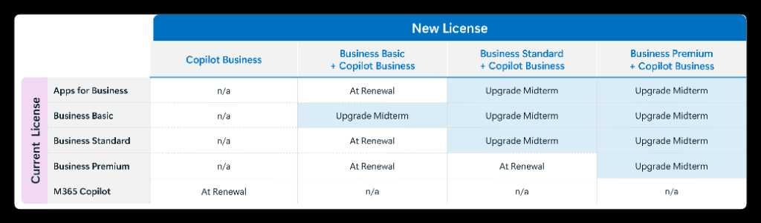
Mid-term upgrade for M365 Business + Copilot Business
Commercial (SMB)
PARTNER SERVICES
Mid-term upgrades for Business offers to M365 Business + Copilot bundles have been enabled for the following paths listed below
For any scenarios that do not support a mid‑term upgrade, customers must wait until their renewal to transition
Copilot Business can be added to a B‑SKU user at any time, while transitions from M365 Copilot to Copilot Business must wait for renewal
Classified as Microsoft Confidential – content under embargo until Nov 18, 2025

Slide 29
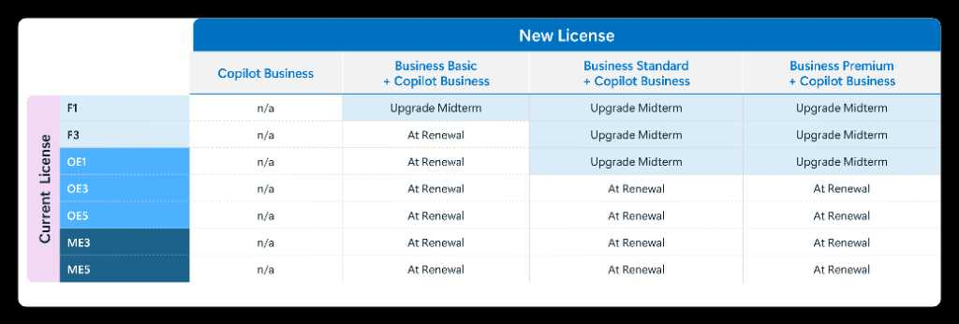
Mid-term upgrade for M365 Business + Copilot Business
Commercial (SMB)
PARTNER SERVICES
Mid-term upgrades to the M365 Business + Copilot bundles have been enabled for the paths listed below
For any scenarios that do not support a mid‑term upgrade, customers must wait until their renewal to transition
Copilot Business cannot be added to users with an underlying F/O/M license
Transition to any M365 Business + Copilot bundle is limited to 300 seats max
Classified as Microsoft Confidential – content under embargo until Nov 18, 2025

Slide 30
Mid-term upgrade FAQ for M365 Business + Copilot Business
Commercial (SMB)
PARTNER SERVICES
When upgrading licenses mid-term, what happens to the subscription end date for the upgraded licenses?
When upgrading from a lower value SKU to a higher value SKU and keeping the same term length, the upgraded subscription will retain the original subscription’s end date.
If the term length changes with the upgrade (i.e. moving from monthly term to annual term), the upgraded subscription will start a new term with a new end date.
Additional clarification for full upgrades (when all seats move to the new SKU).
If the customer started with a 1‑year term and upgrades to another SKU with a 1‑year term, their end date will co-term with the original subscription.
You can choose a longer term if that longer term exists for the new SKU —doing so will start a completely new term.
You cannot restart a new 1‑year term if the original one was already a 1‑year term.
Partial upgrades work differently, as follows:
When upgrading only a portion of a subscription, the upgraded seats will co‑term with the original subscription.
In other words, partial upgrades always keep the same end date as the original subscription—no choice to create a new term.
How billing and proration work:
When seats are upgraded mid‑term, partners will see two billing adjustments:
A prorated refund for the unused portion of the original licenses for the remainder of the term or billing cycle.
A prorated charge for the upgraded licenses for the rest of the term or billing cycle.
Effectively with the mid-term upgrade, you are charged only for the delta in cost.
Classified as Microsoft Confidential – content under embargo until Nov 18, 2025

Slide 31
Sample messaging
PARTNER SERVICES
Focus on developing a narrative that best describes the savings and value making the move to Copilot can deliver through one of the Microsoft 365 and Copilot Business bundle offers.
Key customer challenges
Suggested short messages
Key messages
Sample Copilot pitch copy block
Small business customers are more price sensitive, and are hesitant to commit to something they don’t know how to make the most of
With limited resources, and need to do more with less
Concerns about how to get started, and want a simple approach to starting their AI transformation without all the hassle
For customers less familiar with Copilot:
Discover what’s possible with AI
Maximize your team with AI
Unlock AI productivity now
Boost your productivity with Copilot – now for only $10 per user/month!
For customers familiar with Copilot:
Renew into savings with Copilot Business
Your plan just got smarter with Copilot
Your AI advantage – built into Microsoft 365
Copilot Business bundles provide a single solution, that works across your business and is included with your Microsoft 365 Business plan.
Now with even more bundle savings, enjoy enterprise-grade security at small business pricing. Add 10+ users for only $10 per user/month for a limited time.
Protect your business while scaling. Copilot is built with Microsoft’s trusted security and privacy tools, giving you peace of mind and allowing you to get started quickly and securely.
Most AI tools don’t understand your business. Copilot does. It’s built to work with your team’s files, chats, and emails to help you get real work done. Copilot automates tasks, supports your team, and helps you make decisions and run your business more efficiently.
Find time to be more creative with a Copilot that works alongside you, embedded in the Microsoft 365 apps millions of people use daily, including Microsoft Teams, Word, Excel, PowerPoint, Outlook, Loop, and more.

Slide 32
AI Business Solutions – M365 Business SKU + M365 Copilot Business
Resources
Customer Outcome
Partner Outcome
Enable customers to safely run their businesses from anywhere with a secure, comprehensive, AI-powered cloud solution in a hybrid work scenario, while providing comprehensive AI led business transformation benefits to Customers through Partner led solutions and services.
Drive upsell from M365 BB/BS/BP to M365 B SKU + M365 Copilot Business bundle offer. Drive Wall-To-Wall Copilot coverage by attaching Copilot Chat to bundles
Differentiated Partners Capabilities
Execute campaigns to help generate leads – New customer acquisition, upsell, and Copilot attach
Help build customer intent; Message – Get Copilot ready, vendor consolidation, security concerns
Leverage CSP offers to upsell and acquire customers
Deliver end user Copilot adoption & change management to help drive Wall-To-Wall Copilot coverage
Win Formula aligning to MCEM
1
Listen & consult
2
Inspire & design
3
Empower & achieve
4
Realize value
5
Manage & optimize
Build Pipeline
Target customers and execute campaigns to generate demand.
Position Wall-to-Wall Copilot coverage for all users.
Deliver
Build intent by delivering immersive customer experiences.
Win Deal
Leverage time-bound CSP Promotions.
Navigate customers to use Security for AI Assessment to identify security gaps.
Deploy/Drive Adoption
Address data security and privacy while driving end user enablement.
Drive Expansion
Build business case for expansion to include Copilot Chat and Microsoft Security and Compliance mini-bundles.
Campaign-in-a-box
Cloud Ascent
APSX - ABS & Security Insights
Partner Coop Funds
Partner MDF
Immersion Briefings
Copilot Masterclass
Multi-customer Briefing
CSP Promotions
CSP Incentives
SMB Secure AI Productivity Assessment
ASPX – ABS & Security Usage and Insights

Slide 33
Resources
Microsoft 365 Copilot Business Promotional offers
Introductory promotional pricing available for new offers from December 1, 2025, through March 31, 2026.
Microsoft 365 Business + Copilot bundle offers require a minimum purchase of 10 seats to qualify for promotional pricing
 | Microsoft 365 Copilot Business | Business Basic and Copilot Business | Business Standard and Copilot Business | Business Premium and Copilot Business | Purview Suite for Business Premium*
ERP (per user/month) | $21 | $27 ($6 + $21) | $33.50 ($12.50 + $21) | $43 ($22 + $21) | $10
Promo price | $18 (~15% off) | N/A | $22 (~35% off) | $32 (~25% off) | $5 (~30% off)
Promo Seats (min/max) | 1 to 300 | N/A | 10 to 300 | 10 to 300 | 10 to 300
Promo term | December 1, 2025 – March 31, 2026 | N/A | December 1, 2025 – March 31, 2026
*Purview Suite for Business Premium can only be added to customers that have purchase Business Premium and Copilot Business Or Microsoft 365 Copilot Business
Note: Not all features/product logos shown. Price is subject to change based on subscription term, currency and region.
Notes:
As you look at the opportunity to make AI-powered productivity foundational for SMBs, these new AI Productivity Bundles are critical to enabling that strategy.
By combining Microsoft 365 Business and Copilot Business into a single SKU, you simplify the sales motion and remove friction for customers. Instead of positioning Copilot as an add-on, you can now lead with a complete AI-productivity solution—making it easy for SMBs to adopt AI.
These bundles make upgrading simple and ensure every user has the tools to work smarter and are designed to accelerate adoption and make AI-first productivity the new standard.
These bundles are available for Business Basic, Standard, and Premium combined with Copilot Business starting at $27 per user per month, with options with or without Teams available.

Slide 34
Resources
Partner resources
Copilot Practice Development & GTM Copilot CSP Landing Page | Copilot Getting Started Offer Landing Kit Copilot Getting Started Landing Page | UPDATED! Copilot QuickStart Training QuickStart Training Registration Page
Copilot & agents CSP Briefings Copilot Briefings Kit | Copilot Partner Services Blueprint Download the Blueprint | Copilot Success Kit Download the Copilot Success Kit
M365 Lighthouse (Copilot Insights) Lighthouse for Partners | M365 Copilot 15% Promo FAQ To-Partner FAQ | Copilot Scenario Library See the latest scenarios
Level Up CSP (Digital & In-Person) Level Up CSP Bootcamps Level Up CSP agents hands on labs | Agents CSP Deck Accelerate your CSP business with agents | Global Promo Readiness Guide See the latest Promo Guide
Copilot Wave 2: Spring Release Read the Apr. 23 blog | Agent simulated demos Download demos here

